Slide 1
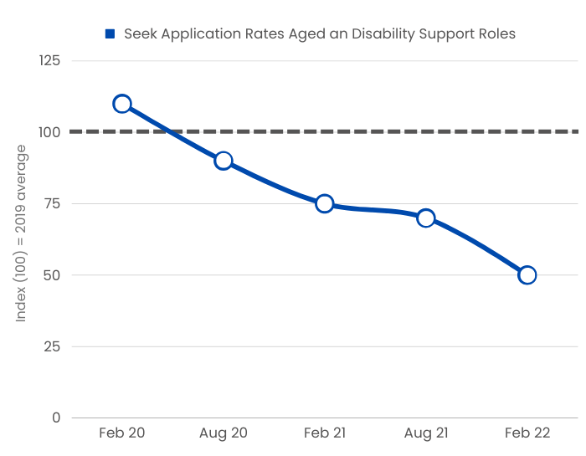
Notes:
#You don’t need anybody to tell you about candidate shortages, as the news has been full of it.
But we would like to open this this discussion by highlighting recent feedback from providers we deal with.
Even though sourcing has been a major challenge since Covid started, candidate numbers and quality have reduced noticeably in the last 6 months. This report from Seek highlights that reduction.
Many have seen staff turnover grow in the last 12 months.
And when we ask them about the impact on their businesses their answers can be grouped into 3 main areas

Slide 2
Hesta State of the Sector Report 2021
Notes:
This is where the referrals come from so this is where efforts are best targeted - approx 60% of existing staff
The important point is that this data confirms what we have seen in the last 12 months and that is that referral has a lot more potential and provides access into a significantly larger candidate pool than most people expect
There is a significant opportunity if you can tap into this channel but traditional referral schemes have not made this easy

Slide 3
Difficult Admin & Operations
Poor Engagement & Strategy
Irregular & Few Candidates

Slide 4
Notes:
That’s why we have chosen to use Care Friends to manage your employee referral policy.
Let’s have a look at what Care Friends is.
https://vimeo.com/685265126 (sound on)

Slide 5
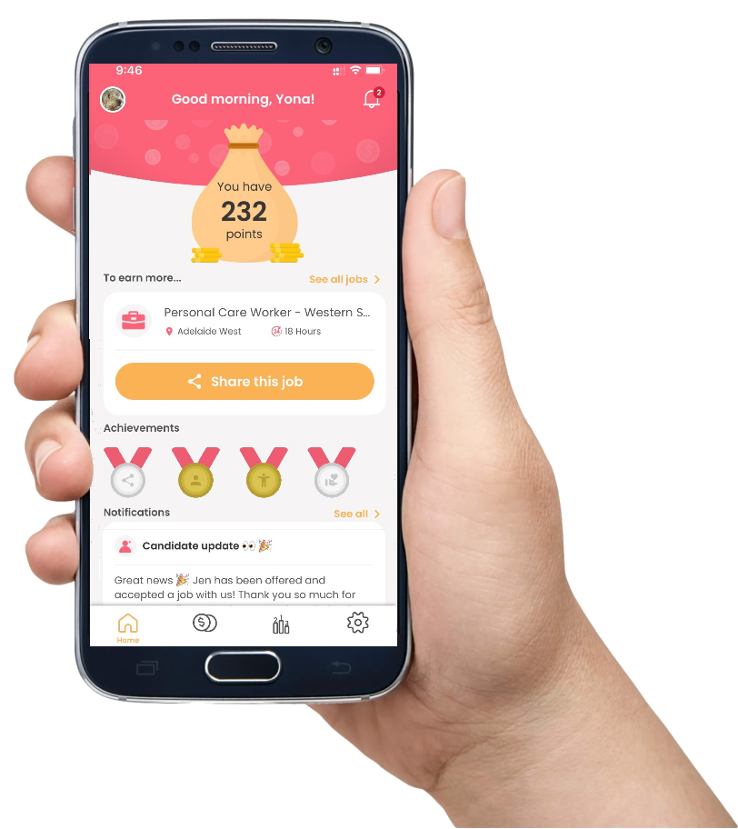
Notes:
There are two parts to Care Friends.
Firstly, the recruiter portal is where the processing takes place, where jobs are posted and the referral candidates progress is kept up to date, and that automatically sends progress updates to the referring employee. If you integrate Care Friends with your ATS the 2 platforms talk to each other, and these processes are automated. The portal is also where the scheme rules are kept as well as your data and analytics.
The second part is the
#employee app. This where employees can easily share job vacancies, they see their referrals’ progress through your recruitment stages and can view their referral rewards and choose to claim their rewards. The app can be branded with your organisation’s colours to keep your marketing department happy as well.

Slide 6
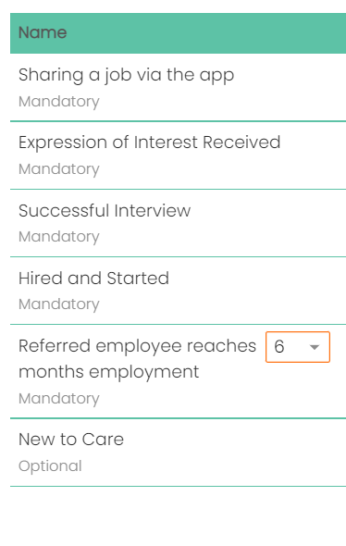
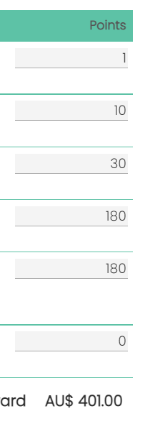
Notes:
Care Friends is a points-based system and you nominate the value of each point- normally 1 point = $1.
With regards to employee referrals - Micro rewards are awarded progressively as the candidate passes through key stages of the recruitment process. So instead of one large pay-out when a referred friend starts work or makes it through probation, the employee is getting increasingly larger rewards the further their referral makes it in the recruitment process.
#Here you can see an example of how a total referral reward of $400 is broken down. Small at the start to reward job sharing through to higher rewards based on candidate success culminating in starting and or reaching a tenure milestone.
we are rewarding actions and results –bias toward success
This type of reward psychology, allows Care Friends to nudge employees to keep referring jobs. It works and is a key part of reward and engagement strategies as you can include a reward for when the referred employee reaches a certain tenure milestone.

Slide 7
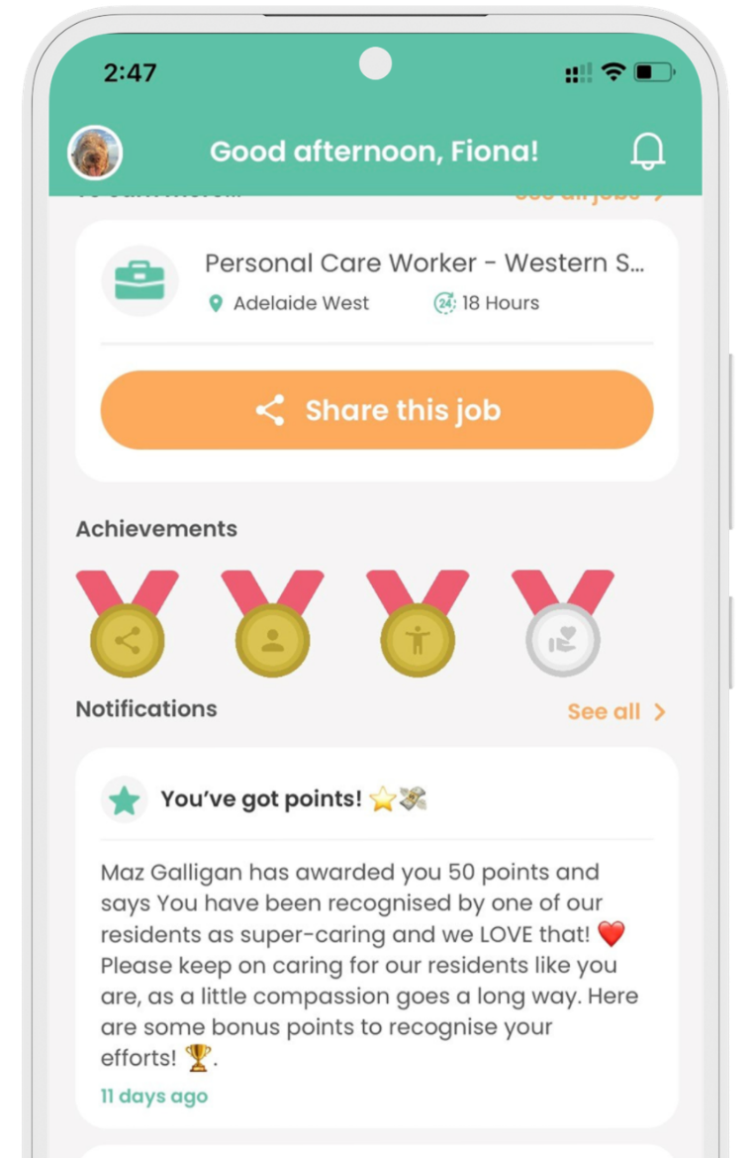
Instantly rewarding
Organised autonomy
Audit trail
Increases referrals
Notes:
The main function of Care Friends is employee referral, however there is additional functionality built in of Bonus Points. This has proved very popular because it is a direct and immediate recognition of an employee’s actions or performance.
#From within the portal, a Manager or other authorised person can assign bonus points to an individual employee, a team or everyone at a site or organisation. This sends a notification to the recipient and immediately adds the bonus points to their money bag. Fun!
#
Moving your reward and recognition program over to Care Friends:
#Makes rewarding instant and can be aligned close to the actual behaviour that is being recognised
#Gives managers an organised, yet autonomous avenue to recognise employees but also gives employees an organised and autonomous avenue to cash in rewards and build their points to cash in WHEN THEY WANT TO
#Provides an audit trail
#Increases the use of Care Friends and thus helps to promote referring as well

Slide 8
Notes:
You can pre-create reward categories with set points and suggesting messaging or leave it up to the manager.

Slide 9
Client A
3 reward categories
50 points each
Managers get 150 points each month to assign as they see fit
Notes:
Many clients have moved their reward and recognition program over to Care Friends and either use it ad-hoc or more formally.
Some examples from current clients
Client A (read from slide)
Brighthearted Helper
Dedicated Expert
Trusted Team Player

Slide 10
Client B
No categories
Flexible points
Rewards for going above and beyond, team outcomes and engagement
Notes:
Client B - Awards random points for things such as going above and beyond in situations relevant to a persons job and more frequently situations relevant to contributing to team outcomes and engagement
ie:
employee was given 50 points for his casual day attire of a matching hawiian shirt, shorts and hat,
Points awarded for cooking the best BBQ at the staff function
Points awarded to the TA team for a brilliant launch of Care Friends and processing of candidates

Slide 11
Client C
3,6,9, 12-month retention bonus
Work anniversaries
Birthdays
Service awards
Notes:
Client C – Have a strong focus on retention
3,6,9 &12 month retention bonus
Work anniversaries
Birthdays
Service awards

Slide 12
Notes:
This is a bit more detail on how the Bonus Point functionality works with the app. You can give managers access to only this part of the Portal to manage this themselves or of course this can be managed centrally.
#
It’s super easy to award bonus points to an individual, multiple people or everyone at a site.
The bonus points are instantly allocated and the message sent to the employee.
How nice is that!

Slide 13
Notes:
Employees can control when to cash in their points which they can do via the app.
# You set the minimum point pay out and how you want to pay them: cash, visa card or perhaps some other way. Our research shows that most care employees prefer cold hard cash.

Slide 14
Questions?

