Slide 1
Employee referral modernised and turbocharged
With Care Friends
Notes:
[maybe it’s best if this intro, is done by the Super User or another representative from the organisation. They will have to explain the reasoning for choosing to increase employee referral, the benefits of this on retention, the need to diversify their recruitment mix. Our task is to show the successes and do the portal training. But in absence of a local supporter doing the intro, we can stick to this.]

Slide 2
Agenda
1
Introduction
Results & Stakeholders
The Referral Process with Care Friends
Scheme Rules
Support & Q&A
2
3
4
5

Slide 3
Notes:
It is pretty clear that our sector is struggling finding the staff it needs.
[click]

Slide 4
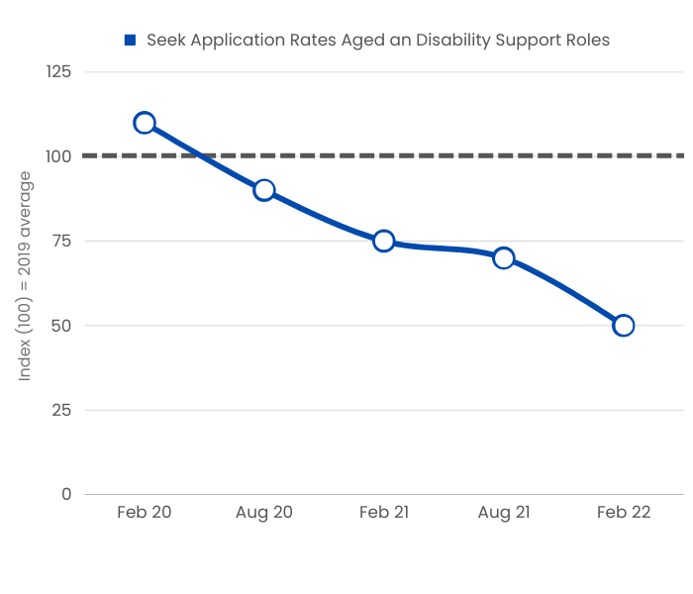
Notes:
It’s becoming harder to find job applicants. This graph shows you that the number of job applicants on Seek for aged care roles and disability support roles has been steadily declining since February 2020. Yet, as you would know, there is an increasing need for more staff across the board.
And it’s not just online job boards. Other sources of staff are also drying up.

Slide 5
Notes:
The visa holder channel and the active job seeker market are not delivering at the moment, the only other option is the passive market– those people who are not actively looking for a job but will respond to a prompt.
#The federal government has spent millions on awareness campaigns such as the “a life changing life”, as well as ongoing initiatives, such as traineeships or Building the Local Care Workforce programmes attempting to activate passive job seekers.
#Employee referral is more direct method of prompting, it is a 1 to 1 approach to recruitment.

Slide 6
Notes:
Recent research by Hesta shows that up to 63% of current aged care employees would recommend working for their employer to their family or friends. That is 6 out of 10 people in your organisation! So an employee referral program would make sense.

Slide 7
Difficult to manage
Hard to keep top of mind
Few candidates
Notes:
However, traditional and paper-based employee referral programs are often
#difficult to manage
hard to keep top of mind with staff
And don’t provide a lot of candidates

Slide 8
Notes:
That’s why your organisation has chosen to use Care Friends to manage your employee referral policy.
Let’s have a look at what Care Friends is.
https://vimeo.com/685265126 (sound on)

Slide 9
Strategic View
Aim
To leverage and increase employee referral as a source of high-quality candidates.
By enabling and rewarding staff for referrals to job vacancies via the use of reward psychology, facilitated by an app and recruiter portal.
Launch well, gain support from the top. Embed employee referral into the business. Recognise and celebrate successes.
Open the employee referral pipeline. Reduce job board spend and agency spend, channelling rewards to staff instead. Improve staff retention.
How
Best Practice
Goals
Notes:
If managed well, Care Friends will open up that employee referral pipeline giving you access to local, good quality candidates who are often passive and hard to reach. Opening this sourcing channel up for you will bring you a nice trickle of candidates who have already been pre-vetted by your employees and will be of better tenure- saving you time on sourcing and retention. It is well worth making this work. Results from other clients are as follows:

Slide 10
Quantity
“Care Friends has made recruitment everyone’s business and the benefits flow to our clients, our staff and our organisation”
David Panter CEO
19% of new starters
Quality
Conversion rate of 1 in 3
Retention is 50% better
Notes:
ECH is a provider of Home care and Accommodation services in South Australia and had a paper-based employee referral program in place.
After implementing Care Friends, they are now getting
# 19% of all starters via referral.
#Almost 1 in 3 referred candidates offered a job
# Retention – referrals are 50% below normal turnover.

Slide 11
Quantity
22 candidates per week
Quality
“What surprised us the most was how easily it has been to implement: we were able to set up and roll out to an entire business unit within 2.5 weeks.”
Lee Robinson- Talent Acquisition Manager, Bolton Clarke
1 in 5.7 is hired
Notes:
Bolton Clarke is a large provider on the East Coast.
After introducing Care Friends, on average they are now getting
#22 candidate per week and
#1 in 5.7 is hired.

Slide 12
Key Stakeholders
Super User
Internal CF contact for all CF activities. Coordinator of all. Project Manager. Scheme Rule controller.
Launch Manager
Often someone from Marketing/Comms. Responsible for launching CF and ongoing engagement comms (internal and external)
CEO, Execs and Management
Walking the talk. Promoting employee referral.
TA/Recruiters/Admins
Responsible for recruitment and pushing referral through the recruitment stages.
Champions
Local CF advocates. Promoting Care Friends use, helping employees use the app. (incentivised)
Payroll
Processing payment requests.
Central HR
Promoting referrals as part of onboarding. Adding jobs to Care Friends & keeping track of new employee job milestone.
Notes:
A good employee referral program is not managed solely by you. The following Stakeholders play a role in the success of your employee referral program.
Management – walk the talk, promote employee referral.
The Super User is the person who is our central contact for Care Friends related things as well as the central contact for the business. They are often the project manager for the launch. They also manage the scheme rules.
The Super User tends to work closely with the Launch Manager. This is often a person from the Marketing/Comms team and responsible for communicating about Care Friends to the business and for the comms on Go-Live day.
Depending on your recruitment model (decentralized or centralized), recruiters or site admins are often responsible for moving candidates through the recruitment process. This now includes moving referrals through the Care Friends portal stages, as this is linked to the heart and soul of the app: the notifications and associated point rewards. Integrations with your ATS are available.
The Super User is supported by local Care Friends Champions. These are people who love the app and love to help others use the app. They can be contacted to help navigate the app and help spread the word at site. They are very important as they are the face and voice of Care Friends at site. We are finding that Champions are very important and suggest they be incentivised during the launch to encourage a certain % of sign up at their site.
Your Payroll person or team will need to ‘pay’ payment requests. They can have their own restricted access to the Care Friends portal to do this or be provided with a spreadsheet each pay run. Someone will have to approve the requests in the portal.
Central HR - They can be used in various ways but usually are involved often around the ongoing engagement & onboarding piece, aswell as the job offered stage, possibly the retention milestone.

Slide 13
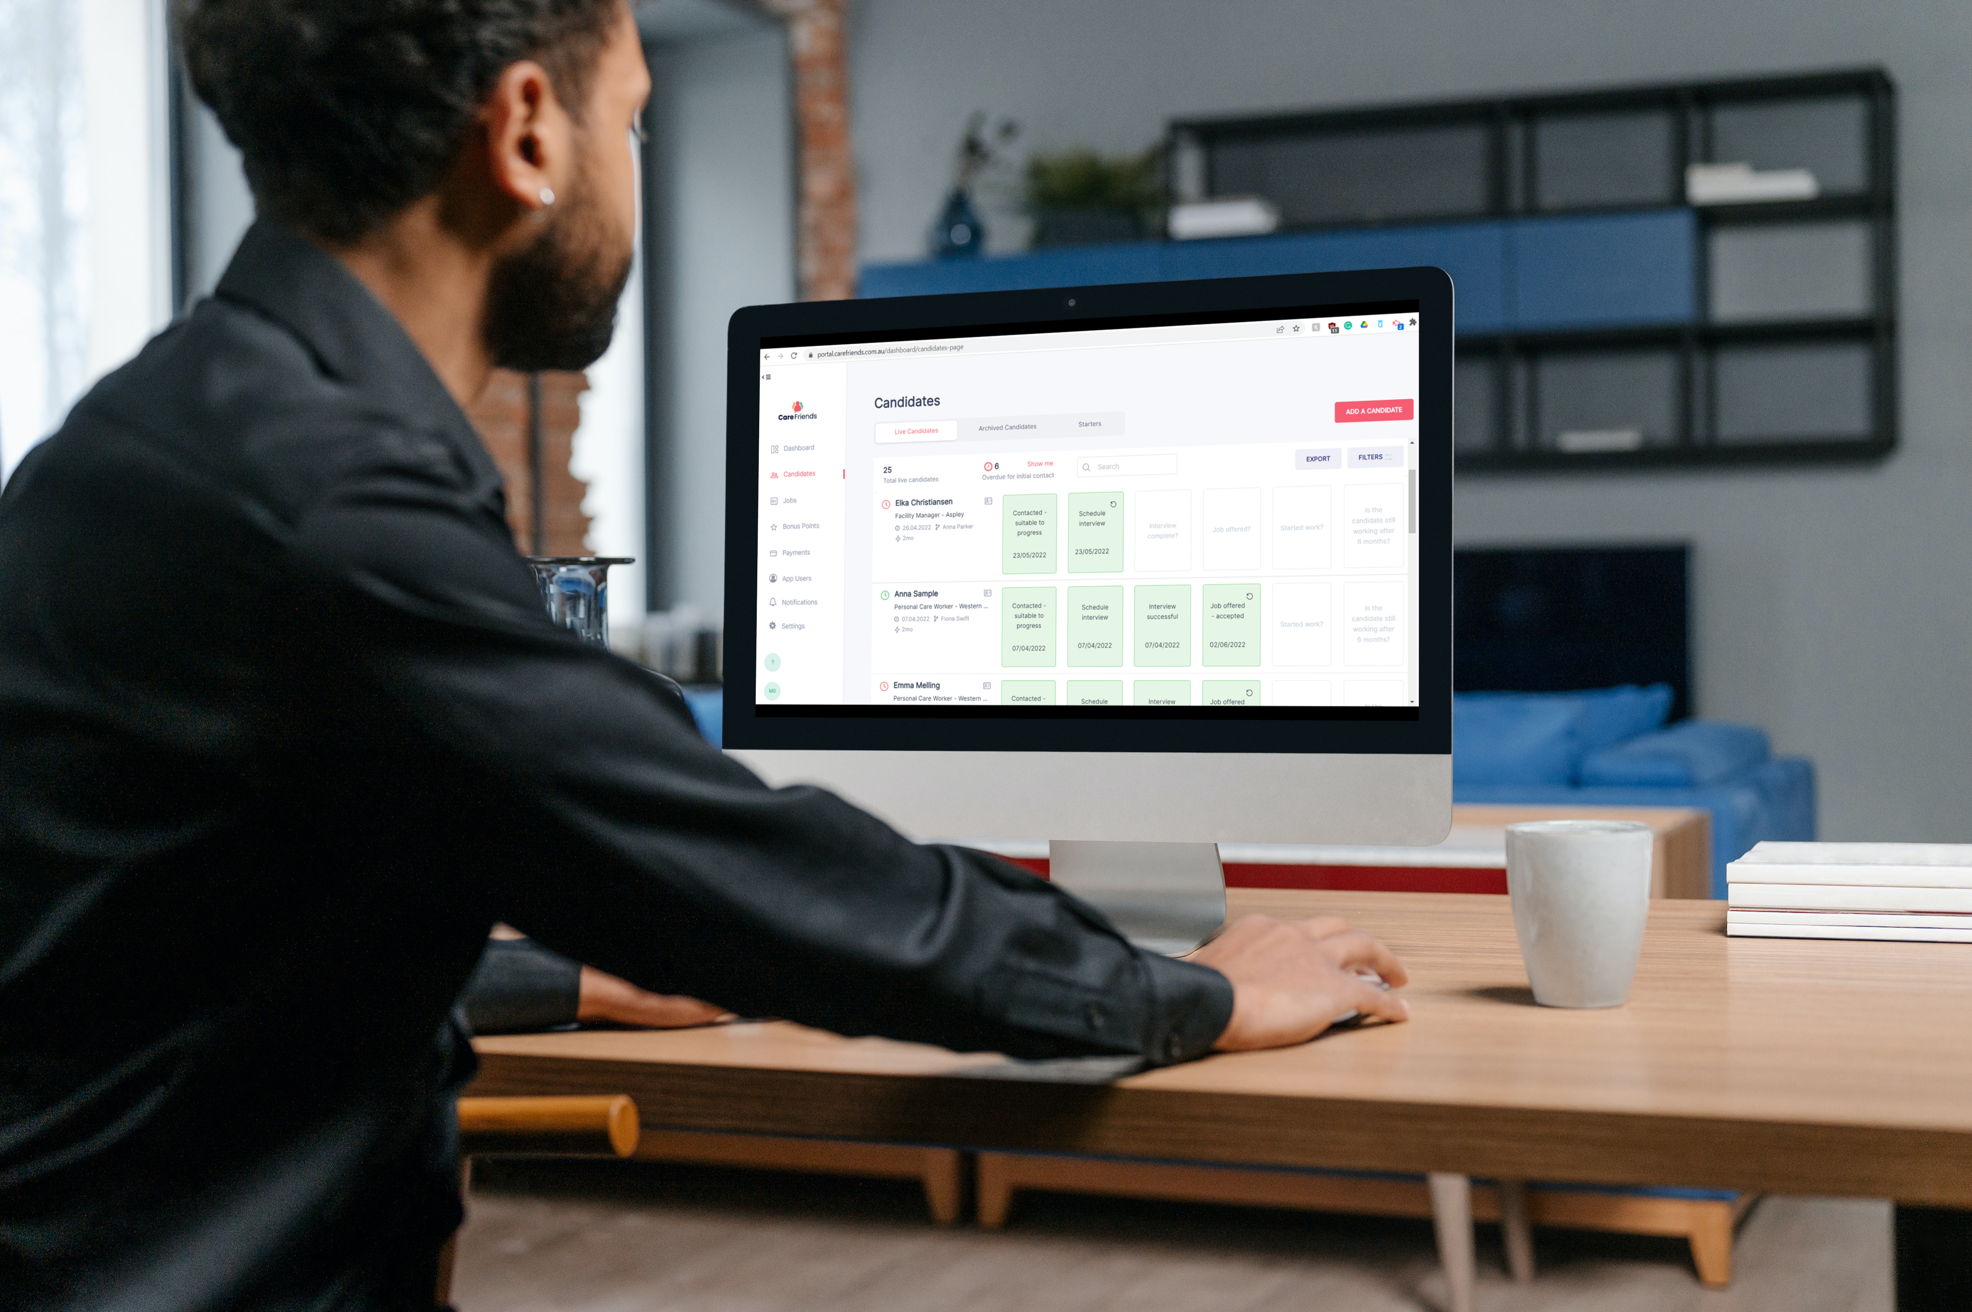
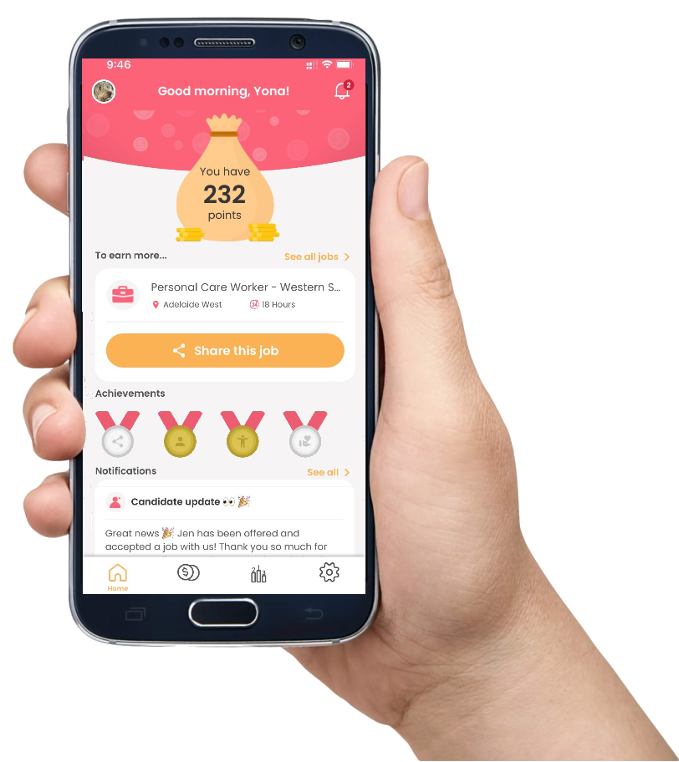
Notes:
There are two parts to Care Friends.
Firstly, the recruiter portal is where the processing takes place, where jobs are posted and the referral candidates progress is kept up to date, and that automatically sends progress updates to the referring employee. If you integrate Care Friends with your ATS the 2 platforms talk to each other, and these processes are automated. The portal is also where the scheme rules are kept as well as your data and analytics.
The second part is the
#employee app. This where employees can easily share job vacancies, they see their referrals’ progress through your recruitment stages and can view their referral rewards and choose to claim their rewards. The app can be branded with your organisation’s colours to keep your marketing department happy as well.

Slide 14
Why Care Friends turbocharges referrals
Easier Admin/Automation
Micro-rewards and gamification
When a job is posted, all app users are notified
Auto email when EOI arrives
Referral progress updates via notifications to employees
Audit trail and reporting
Bonus Points and Notifications
Action | Points
Downloading the app (welcome points) | 10
Sharing a job via the app | 1
Expression of interest received | 7
Successful interview | 22
Hired and started | 120
Referred employee reaches 6 month employment | 150
Total referral reward (minus the welcome points) | 300
1 point = $1
Notes:
Care Friends turbocharges employee referral firstly
#because it is easier to manage and uses automations. So when you post a job, all app users get a notification on their phone to alert them. When someone puts in an expressions of interest form for a certain job, the associated recruiter is automatically notified via email.
When a candidates moves through the recruitment stages, and you update their progress in the Care Friends portal, the referring employee is automatically notified of this progress and awarded points.
The Care Friends portal keeps track of all the referrals and the reporting helps you measure your success
Lastly, the portal can also be used to send notifications to employees via the app and for bonus points.
#The second reason why Care Friends turbocharges employee referral is because it is rewarding and fun for employees to refer their friends. So instead of one large pay-out when a referral start the job or makes it past probation, the employee is getting increasingly larger rewards as their referral makes it further into the recruitment process. This promotes employees to refer quality candidates. One point equals one dollar.
The app itself is fun and easy to use and uses gamification elements to keep staff engaged.

Slide 15
Some key rules
All fulltime/parttime/casual employees are eligible to download the app and use it to earn referral points
You can share a job via Care Friends as many times as you like, but you can only receive points for the first 10 shares you make per calendar month
Shares must be made in good faith i.e. you must believe that the person or people you are sharing with could be interested in a position at our organisation(and suitable for the role!)
Internal candidates are not eligible for referral or rewards within our referral program
Notes:
There are some of your key scheme rules. The full rules can be found in the app or from within the portal.

Slide 16
Rules & Eligibility
You can request to pay out your points at any time, however you must have a minimum amount of points before you can cash them out
Points will be ‘paid out’ in the normal payroll – they are therefore subject to tax and normal deductions
All approved payments will be made within a month of the date we receive the cash in request
There is no limit on the number of points that you can accrue before payment is made
Notes:
Payment rules

Slide 17
Referral Process
Responsible | Task | Description
 | Add Job | Via pre-arranged templates in Care Friends (site) or via HR Department
 | EOI received | A notification is sent to the responsible person for the job. Set a turnaround time for initial contact with candidate (15 minutes is ideal, within 24 hours is recommended).
 | Make contact | Phone screen and request resume.
 | Book Interview | Book and complete interview, advise HR of outcome if necessary
 | Outcome Interview | Update the Care Friends portal candidate screen of the interview outcome.
 | Job offered? | Complete internal processes and update Care Friends portal.
 | Started Work | Update the Care Friends portal candidate screen.
 | Retention Milestone | Update the Care Friends portal candidate screen.
Notes:
Before we start the portal training, I want to take you through some important tasks. These tasks are the same as what you would normally do in your recruitment process. The bold tasks are where automatic notifications go out to staff and points are allocated if relevant.
The first task is to post vacancies. You can choose to pre-create templates for your most-used roles and then activate and deactivate them, or copy/create a new job for each vacancy.
Once the job is posted, your employees will share these with their network. When someone expresses their interest, the responsible recruiter attached to that job will be notified via email. So if you decide to use template jobs, make sure that the correct recruiter is attached to it.
Referrals are a bit different than your normal job applicants that you get via online job boards. They are different because your employees will often already have spoken with their friend about the job. Plus they wouldn’t refer someone if they didn’t think that they would make a good employee. As such, the quality of referred candidates is higher than what you get from online job boards and this is a reason to follow up on an expression of interest as soon as possible. We recommend the same day. The sooner the better.
By the way, when an employee refers a job to a friend and that friend expresses interest, the employee is automatically notified and gets their next set of referral points. You don’t have to do anything there.
However, as you’re progressing the referral through your recruitment stages, it IS important to update Care Friends as well. I will show you this once we hop into the portal, but there are two key stages that are super important to update: the first one is the outcome of the first interview. Regardless of the outcome, the employee will be notified once you update the status, however they will also receive the next lot of referral points if the interview was successful. The next important one is if the referral started work. You will have to liaise with the hiring manager as this step needs to be updated close to the referral’s first day on the job. This also notifies the employee and allocates a bigger lot of referral points. Because the employee is notified that their referred friend started work, it reminds them and often they will check in with their friend to see how things went. That automatically helps to improve retention!
Lastly, there is the retention milestone. For your company this is set at XX months. The responsible recruiter will get an email asking if this retention milestone has been met and reminds you to update the Care Friends portal. A notification is sent to the referring employee and the last lot of points allocated.

Slide 18
With Care Friends 1 in 5 referrals is hired. That is much higher than the 1 in 50 via online job boards.
But how do we do that?
Post jobs regularly (but not too often)
Contact a referral ASAP
Update referrals as they progress through the recruitment stages

Slide 19
Care Friends Launch Day
DATE of launch
Text invite to employees around 9.30am
Encourage staff to download the app
Get ready to process referrals
Notes:
A text message invitation will be sent to personal mobile phones to download the app around 9.30am
Morning Tea (preferably)
Champion Introduction - wear lanyards
Encourage staff to download the app then and there!

Slide 20
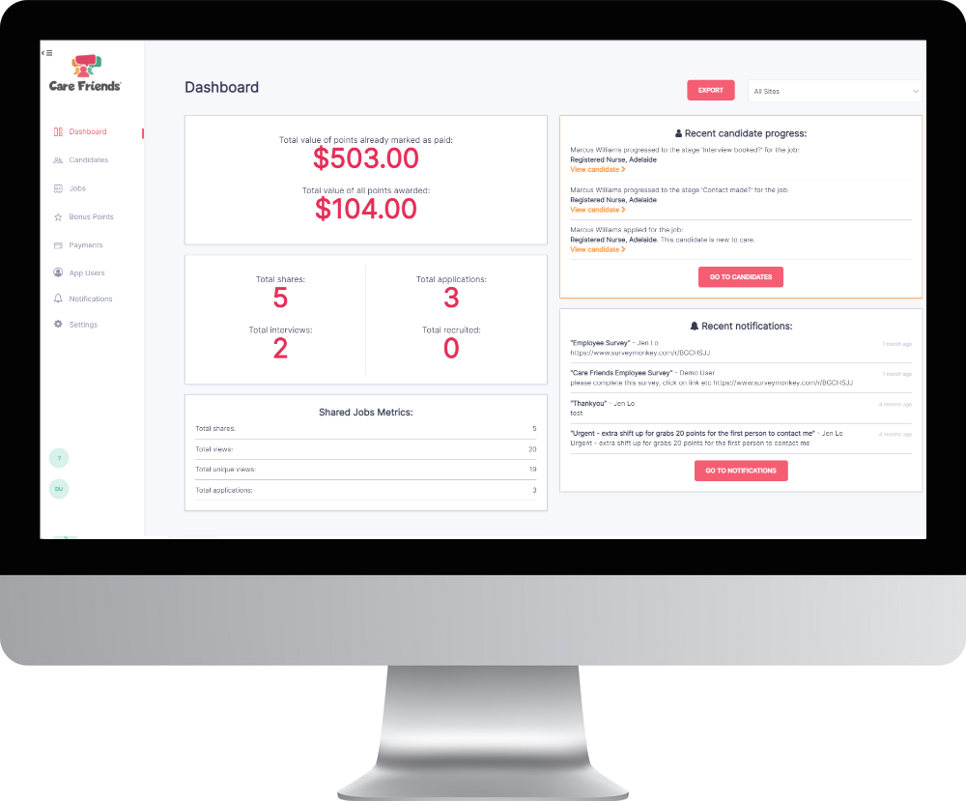
Portal Training

