Slide 1
Employee Referral, but more fun and rewarding
With Care Friends
Notes:
[Use this presentation to present about your employee referral program and Care Friends to your Champions. Change it as you see fit. Suggested notes are included for most slides. Information between square brackets is FYI. The hash symbol # signifies a “click” in the presentation.]
[add your logo]

Slide 2
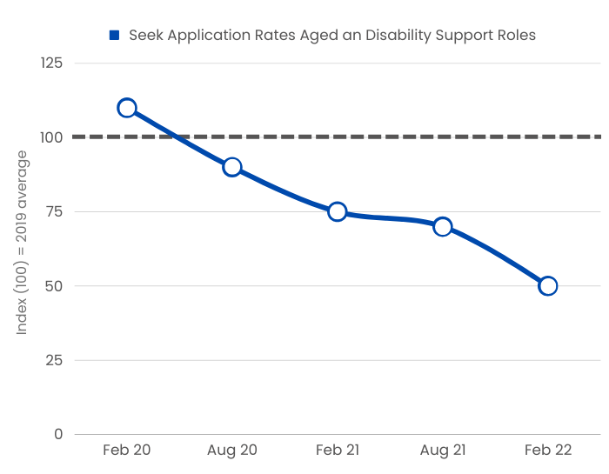
Notes:
It’s becoming harder for our recruitment team/talent team to find job applicants. This graph shows you that the number of job applicants on Seek for aged care roles and disability support roles has been steadily declining since February 2020. Yet, as you would know, there is an increasing need for more staff across the board.
Other sources of staff that our recruitment team normally relies on are also struggling.

Slide 3
Notes:
Recent research by Hesta shows that up to 63% of current aged care employees would recommend working for their employer to their family or friends. That is 6 out of 10 people here in this room! So we are asking for your help. Help us find likeminded and caring people like you.

Slide 4
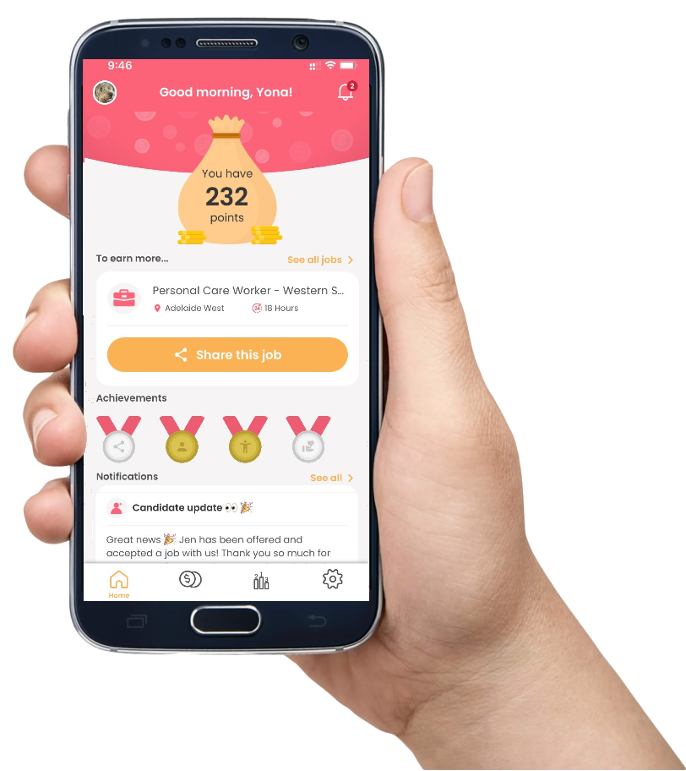
Easy
Fun
Rewarding
Notes:
And of course we want to make it
# easy, fun and rewarding for you to refer!
That’s why we have decided to start using Care Friends as our employee referral reward platform.
Care Friends is an app that you download on your phone. Via this app you can easily share our jobs with your network via text message, email or social media. Our new referral program via Care Friends is being launched today and that’s why we are here to celebrate.

Slide 5
Action | Points
Downloading the app (welcome points) | 10
Sharing a job via the app | 1
Your referral completes the expression of interest form | 10
Your referral successfully completes the job interview | 50
Your referral is hired and finishes their first day on the job | 289
Your referral reaches XX months of employment | 150
Total referral reward (minus the welcome points) | 500
1 point = $1
Notes:
And the best part is that you get rewarded for each step in the recruitment process that your referral successfully completes.
# This is how we will reward you:
[read from the slide and explain each step]
And 1 point equals 1 dollar.

Slide 6
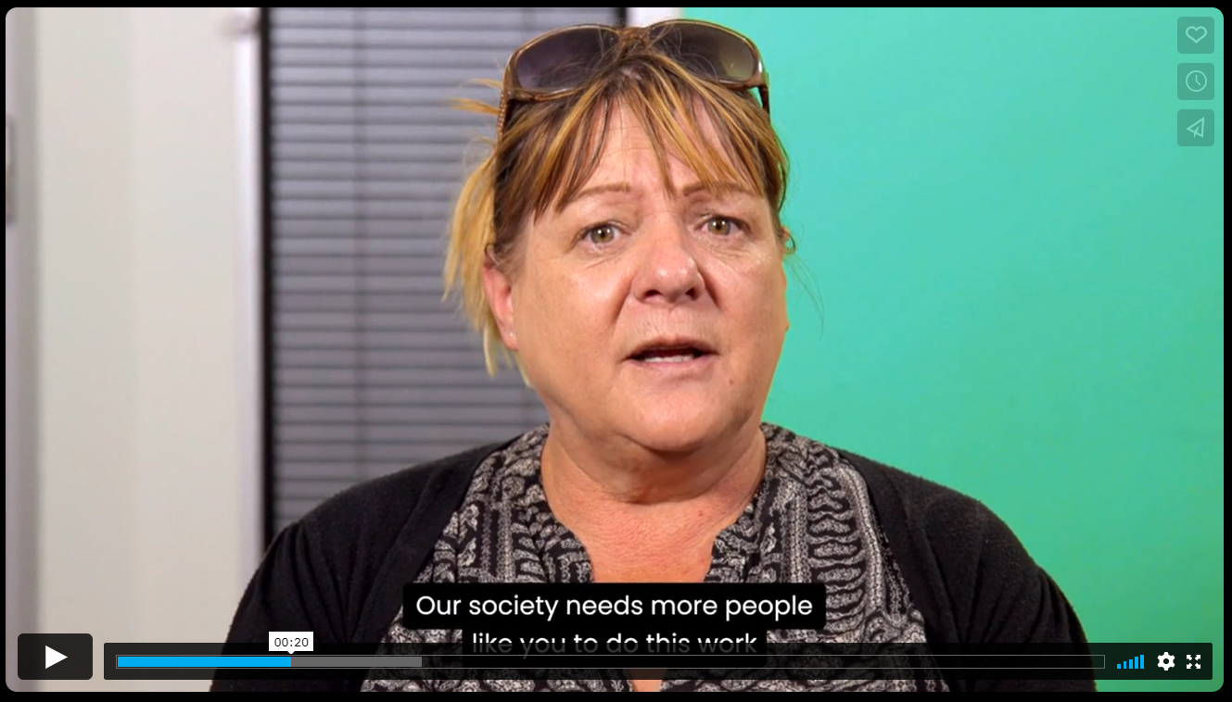
Notes:
Let’s see what Care Friends is and how it helps to make referrals easier, fun and rewarding.
[https://vimeo.com/687797323 (has sound)
If no internet, just keep on going. Please note, that this video mentions bonus points and assumes points are cashed in for points. Ideally this video is replaced by your own video in which the CEO/Exec or an employee talks about the program. Feel free to ask us for a larger version of this video to use scenes from].

Slide 7
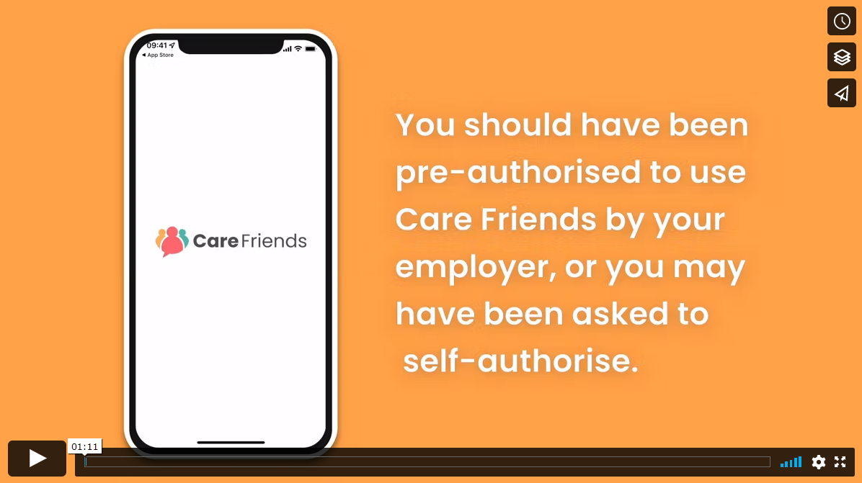
How to download the app
https://vimeo.com/688225762
Notes:
So today you will receive (or have already received) a text message on your mobile phone, inviting you to download the Care Friends app so you can start sharing jobs with your network and be rewarded. This is how you download the app.
[Show the video on how to download the app. If no internet, unhide the next slide instead.]

Slide 8
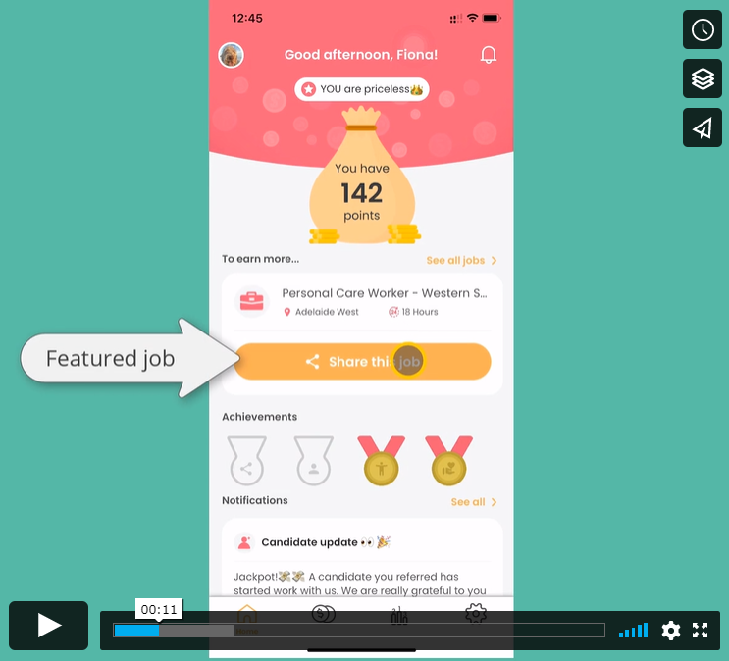
A quick tour of the app
Notes:
This video shows you how to do some key actions in the app, such as sharing a job and cashing in points.
[Show the video with a 2 minute tour of the app. No sound]
https://vimeo.com/737735658

Slide 9
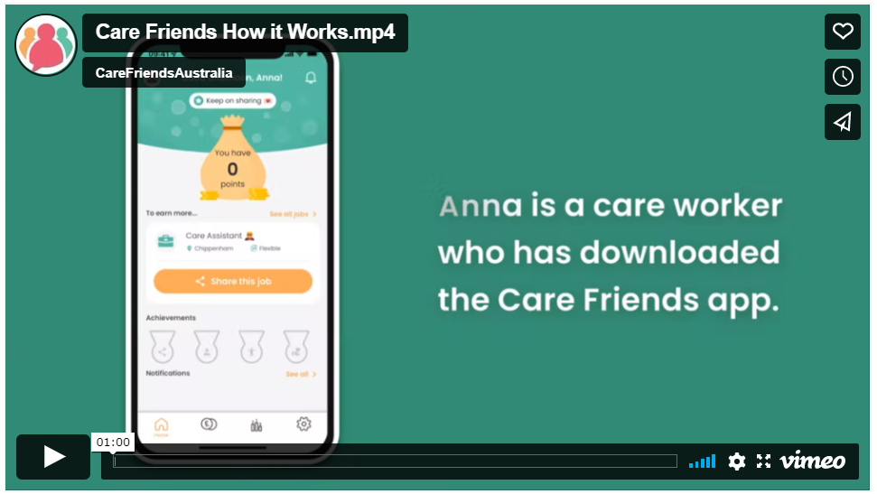
How sharing works in detail
https://vimeo.com/674696316
Notes:
This short video briefly shows how to share a job and what happens when your friend expresses their interest.
https://vimeo.com/674696316

Slide 10
Referring qualified/eligible candidates is a must. For example, referring someone who is not a nurse to an RN role will not result in points.
Referrals have to live within a commutable distance to the job location or planning to move to the area
You can cash in your points at any time once you reach XX points ($XX).
Referrals must be made using the Care Friends app.
You can share a job advert via Care Friends as many times as you like, but you will only receive points for the first 10 shares each calendar month
You cannot refer someone who already works for us
Notes:
There are some rules and here are the most important ones. You can find the full T&Cs in the app itself.

Slide 11
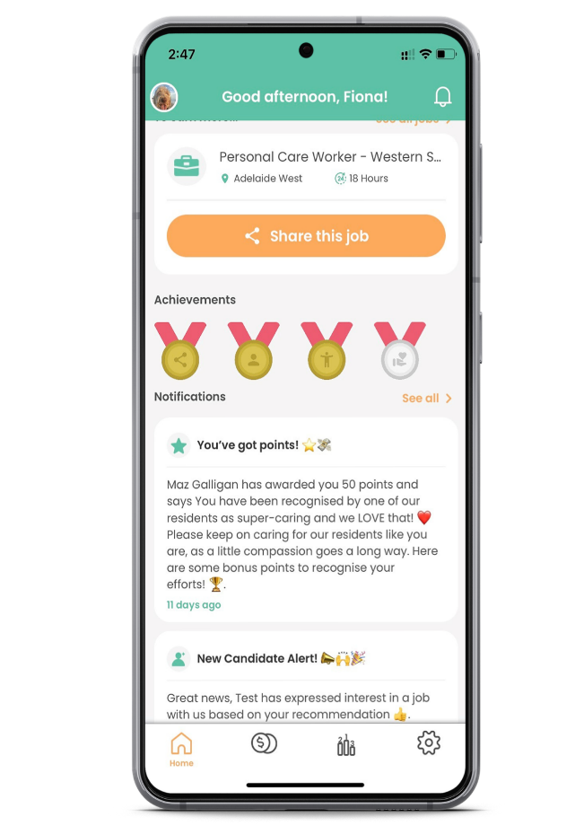
Living our values
Employee of the month
Taking on an extra shift
Notes:
We will also be using Care Friends for our reward and recognition program. So you can get bonus points for doing things such as:
[click]
[insert your own reward categories here and update in the slide].

Slide 12
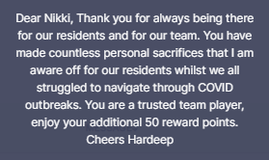
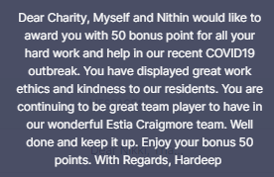
Your Bonus Rewards
Action | Bonus Points
Birthday | 20
Work anniversary | 50
Positive client feedback | 50
Taking on an extra shift | 50
Notes:
[[remove slide if not applicable or customise as per your situation]
#And these are the points associated with each reward category.
#On the right-hand side are some lovely personalised notifications that have gone out to employees when awarding bonus points

Slide 13
Location 1
Bonna Bueno
Location 2
Fiona Friend
Location 3
Shaneeta Sharer
Location 4
Linda Lovely
Location 5
Annie Alliance
Location 6
Con Collaboration
Location 7
Carrie Carer
Location 8
Supita Support
Notes:
We are almost at the end of this presentation but before we go I want to introduce you to your Care Friends champions. Your champions are here to help you with downloading the app, sharing jobs, cashing in your points and any other questions you have about our referral program.
Also keep an eye out for some updates on how the program is going and how many referrals have been hired.
[introduce champions either in this slide or live during this presentation]

Slide 14
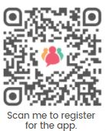
Scan this QR Code with your personal mobile phone and enter your personal phone number and personal email address to get started!
(this QR code is for when your employees have been pre-authorised and their details have been added to the portal)
Notes:
[Insert your own QR code here]
Now get out your personal mobile phone and scan this QR code to download the app or look for the text message from Care Friends with your invite. Ask your champions for help if needed. Please register with your personal mobile and personal email address.
We hope that together we can find more people to work for us and provide the care our clients/residents count on.
[change this if you have chosen to use employees’ work mobile or work email]

