Slide 1
Our new Employee Referral Program
Notes:
[Use this presentation to present about your employee referral program and Care Friends to your Champions. Change it as you see fit. Suggested notes are included for most slides. Information between square brackets is FYI. The hash symbol # signifies a “click” in the presentation.]

Slide 2
Why employee referral is so great
Jobs boards are not delivering
Immigration & Visa holders are minimal
Competition for staff from other sectors
Employee Referral reaches passive job seekers
Best source of high-quality staff
Higher retention rates for both referee and referral
Let’s turbocharge referral!
Notes:
We have invited you here to introduce you to a new initiative we are about to roll out at [organisation]. It’s a new employee referral policy, and although it’s not really new, the way we are going to do it is new. We used to have a paper-based referral policy in place, but we will change this over to a referral app called Care Friends. With Care Friends we want to make employee referral more accessible to everyone, more fun and more rewarding.
And we want you to play an important part in this.
But why are we focusing on employee referral? Well, because it’s great!
#You might know that our sector is finding it really hard to find staff for several reasons.
#But with employee referral we are hoping that all our employees can help find more staff for us and be rewarded for it.
Research shows that employee referral is the best source of great staff with higher retention rates for both the referral and the referee.
And higher retention rates and more staff means more continuity of care for our clients and residents as well as less stress for our employees. And we value this a lot.

Slide 3
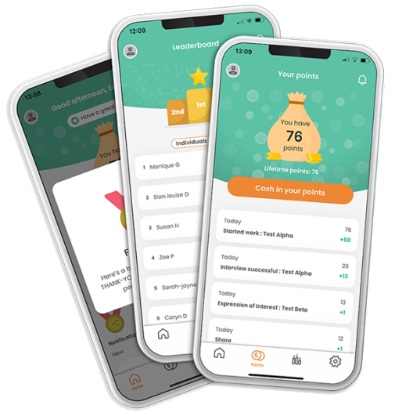
What is Care Friends and why are we using it?
New employee referral and reward app for the health care and social assistance sector
It helps to increase referrals by making referring easy, fun and rewarding via the use of an app.
Notes:
Care Friends will help us to make our referral policy easy to use for employees, fun and most importantly, rewarding.

Slide 4
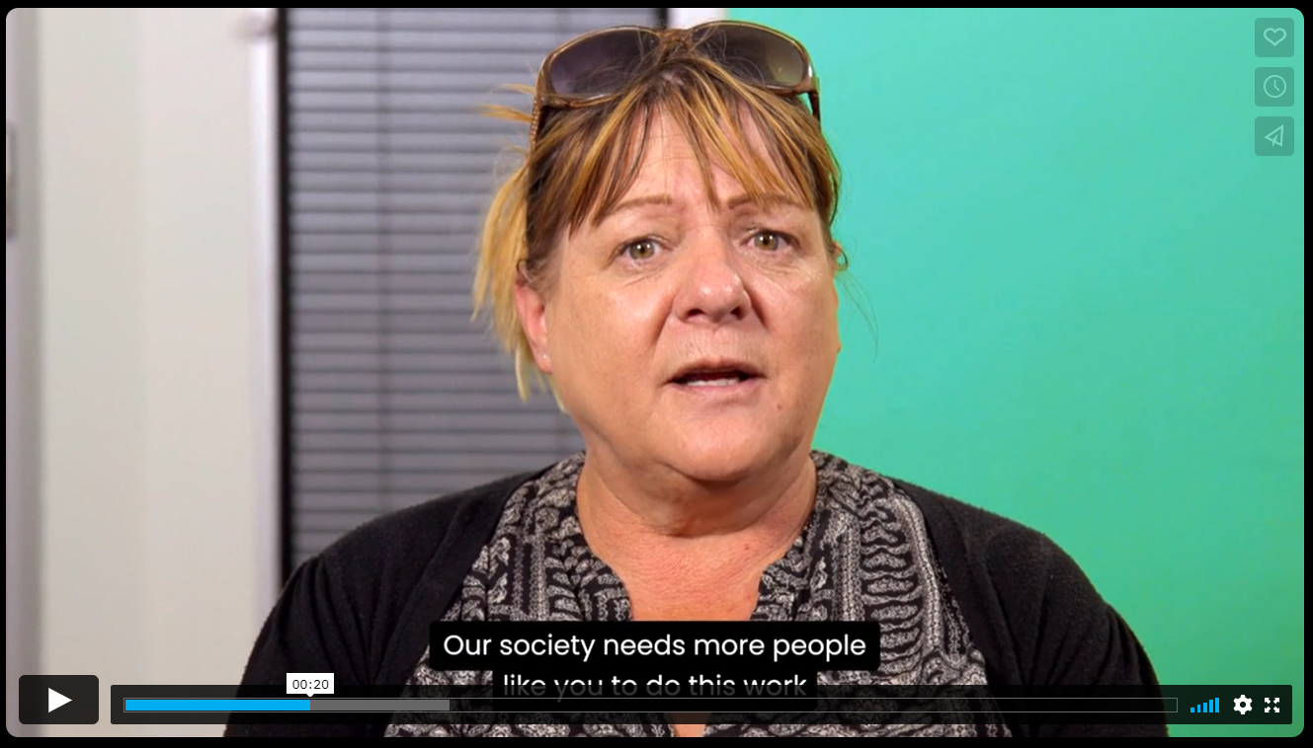
Care Friends Introduction
https://vimeo.com/687797323
Notes:
[play the introduction video. If no internet, just keep on going. Please note, that this video mentions bonus points and assumes points are cashed in for points. Ideally this video is replaced by your own video in which the CEO/Exec or an employee talks about the program. Feel free to ask us for a larger version of this video to use scenes from].

Slide 5
We want to make referral everyone’s business
Talent Acquisition
CEO & Execs
Champions
Employees
Notes:
The roll-out of this new initiative is everyone’s business and we have full support from our
#CEO and Management. They will be walking the talk and promote referral with their teams.
#For our Talent Acquisition Team, Care Friends is a strategic way to diversify recruitment sources and improve retention within our business. Because research shows that people who were referred into a job tend to stay longer. And that’s what we ultimately want: more continuity in our teams and for our clients.
#And our employees is where all the referral magic will happen. Every employee has their own network of family, friends and acquaintances. Research shows that for every 10 employees in a business, an organisation gets between 6 and 15 referrals!
#But one of the most important aspects of our new employee referral program are our Care Friends Champions.
Campions are local referral advocates who are well-connected to employees at their site. You are here because you have been identified as someone who could be an excellent Care Friends Champion and we thank you in advance for your help. Because we do need it. And we do also reward you for it. But more on that later.
[Add anything else as you see fit]

Slide 6
The role of the Care Friends Champion
Be the local advocate for Care Friends
Help during launch day
Assist with downloading and using the app as needed
Remind colleagues to use the app and refer their friends
Share successes during team meetings
Notes:
So what does a Care Friends Champion do?
# [click for each sentence to show. Read from slide].
[Add anything else as you see fit]

Slide 7
Our referral reward
Action | Points
Sharing a job via the app | 1
When the referral expresses interest in a job | 5
When the referral has a successful job interview | 30
When the referral is hired and has started work | 150
Referred employee reaches X months employment | 250
Total referral reward | 436
1 point = $1
Notes:
[update numbers with your details]
Let’s first start with how we are rewarding referrals. And this is a bit different than what you might be used to. Because instead of paying out the total referral reward when the referred candidate is hired or finished their probationary period, we have broken up this reward into smaller chunks and have attached them to certain milestones in the recruitment stages.
#For example:
[read out from slide]
And the best part: 1 point equals 1 dollar!

Slide 8
More rewards
We will also give everyone who downloads the Care Friends app XX welcome points
And as our Champion you will get bonus points when your site reaches a certain percentage of app users (first 3 months after launch)
Sign Up | Bonus Points
10% | 20
25% | 50
50% | 50
75% | 50
1 point = $1
Notes:
[this is just an example. Please include your own information here]
Everyone who downloads the Care Friends app automatically gets XX points to welcome them.
#As a Champion we want to recognize your efforts and support at site. So when XX% of employees at your site have downloaded the app, we will award you an extra XX points. When your site then reaches 25% sign up, an additional XX points will come your way. And so on.

Slide 9
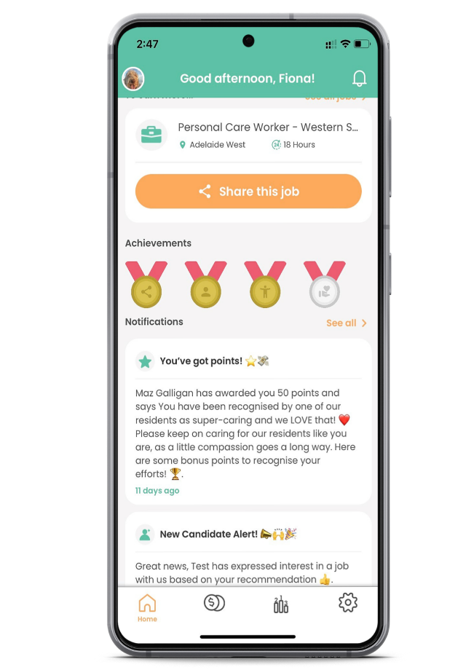
Bonus Points – Reward and Recognition
Notes:
[remove slide if not applicable]
We will also use Care Friends for our Reward and Recognition program.
[give some more info on your R&R program]

Slide 10
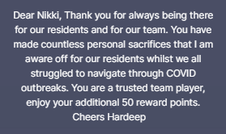
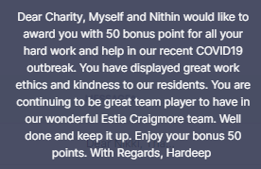
Bonus Points – Reward and Recognition
Your Bonus Rewards
Action | Bonus Points
Birthday | 20
Work anniversary | 50
Positive client feedback | 50
Taking on an extra shift | 50
Notes:
[[remove slide if not applicable or customise as per your situation]
On the right-hand side are some lovely personalised notifications that have gone out to employees when awarding bonus points -

Slide 11
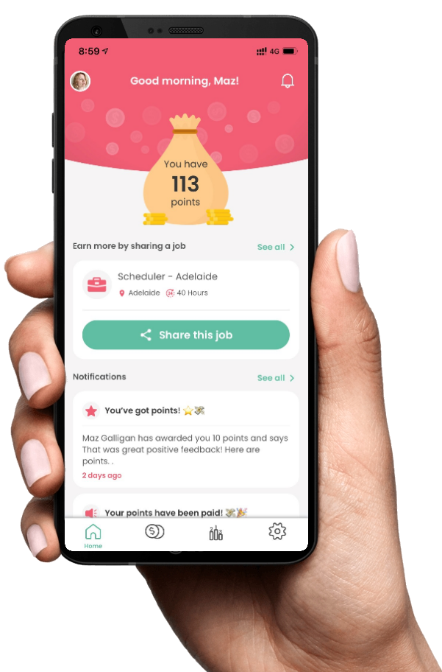
The App!
Notes:
Now let’s have a quick look at the Care Friends app
[if possible, give Champions early access to the app so they can have a play with it before the official launch].

Slide 12
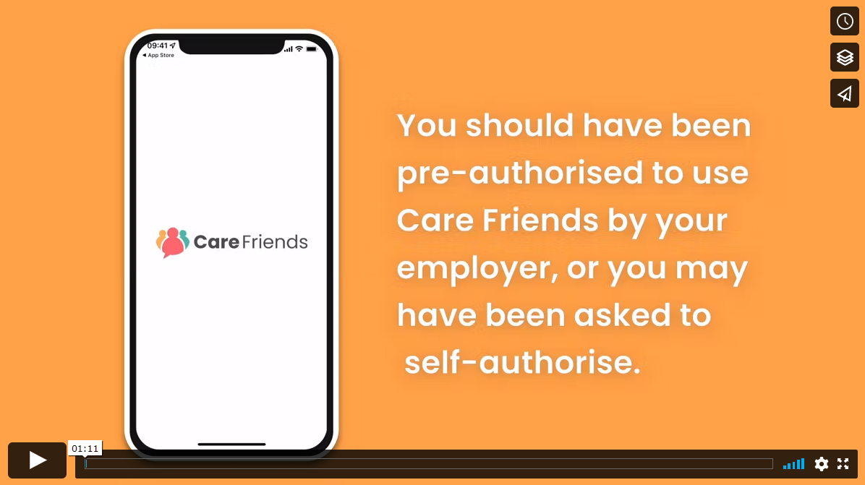
How to download the app
https://vimeo.com/688225762
Notes:
[Show the video on how to download the app. If no internet, unhide the next slide instead.]

Slide 13
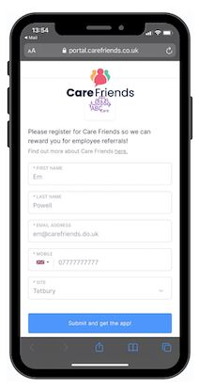
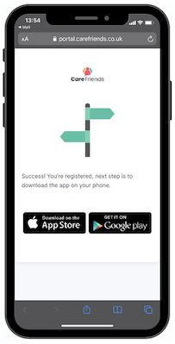
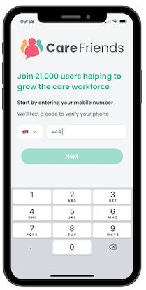
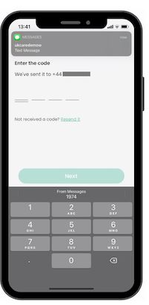
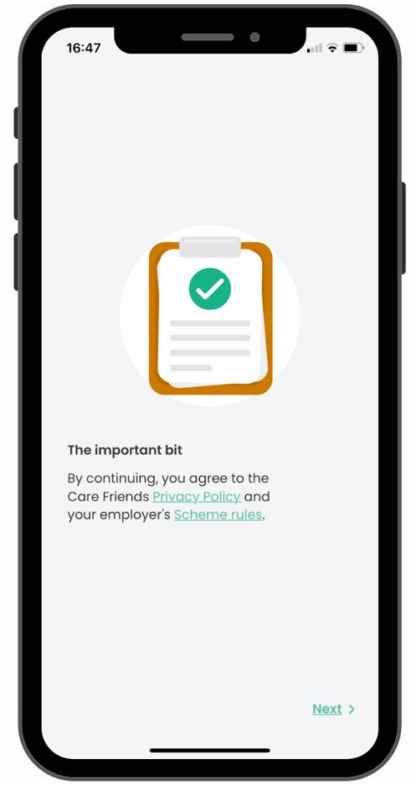
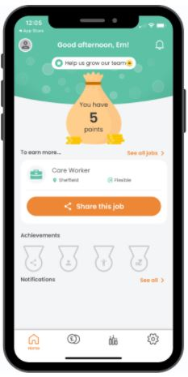
How to download the app
1
2
3
4
5
6
Click on the link you received via text message. Enter your details.
Download the app from your phone’s relevant app store
Enter your mobile phone number,
Enter the one-time passcode that you receive via text.
Read and agree to the scheme rules and be shown a few benefits.
Tap on the ‘next’ icon to move through the screens and land on your homepage!

Slide 14
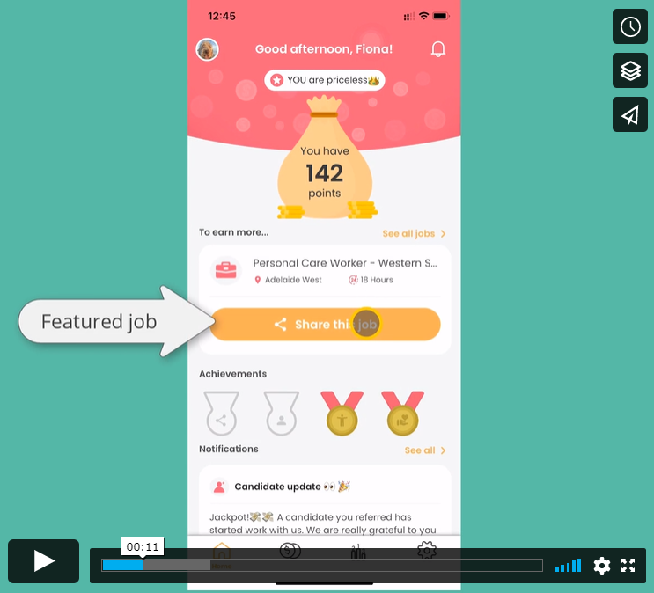
A quick tour of the app
https://vimeo.com/737735658
Notes:
[Show the video with a 2 minute tour of the app. If no internet, unhide the next 3 slides instead.]

Slide 15
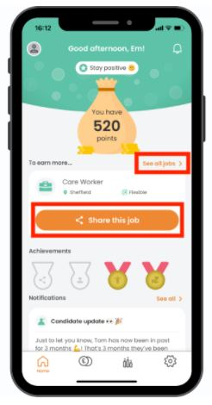
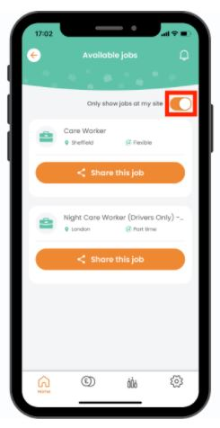
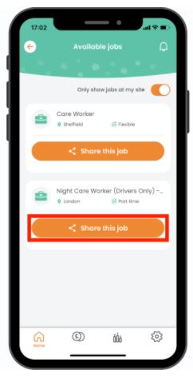
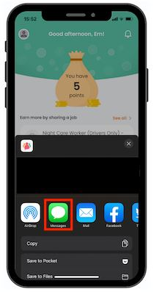
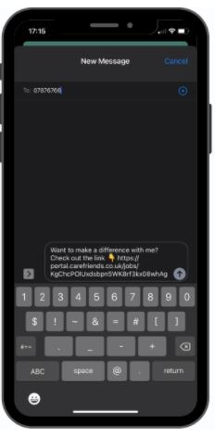
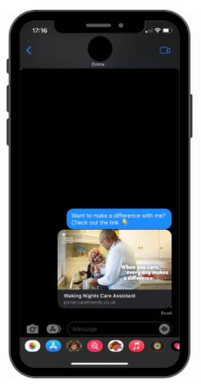
How to share a job (or watch video here)
1
2
3
4
5
6
Click ‘share this job’ on the home screen or ‘see all’ in the top right hand corner.
Toggle the button to change the site view between jobs at your site only, or ALL jobs.
Scroll through the list of jobs and choose the job you would like to share then tap’ share this job’.
Scroll through your sharing options that appear on your phone, in this case we have selected text message.
Enter the name or number of the person you would like to share the job with and add a personal message.
Tap ‘send’. The message will appear to your friend with an image and a link to find out more and apply!

Slide 16
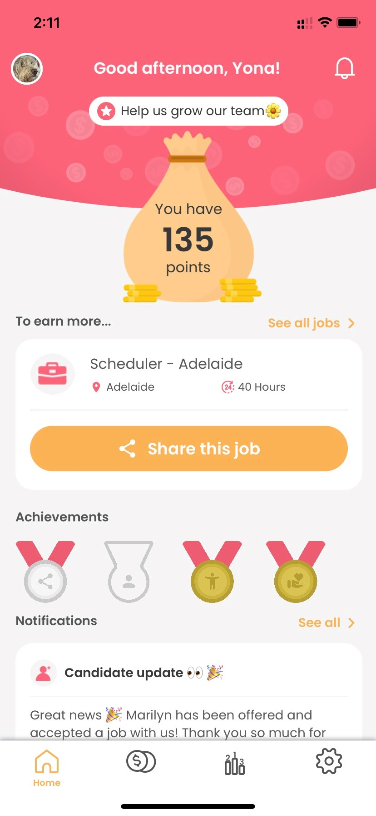
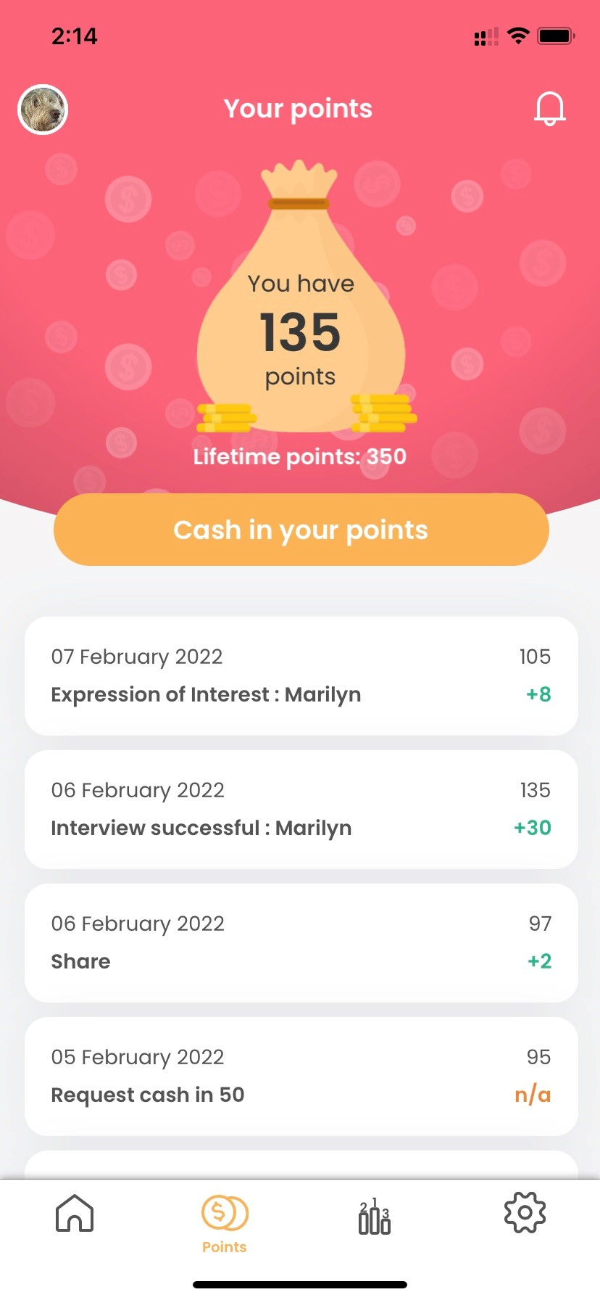
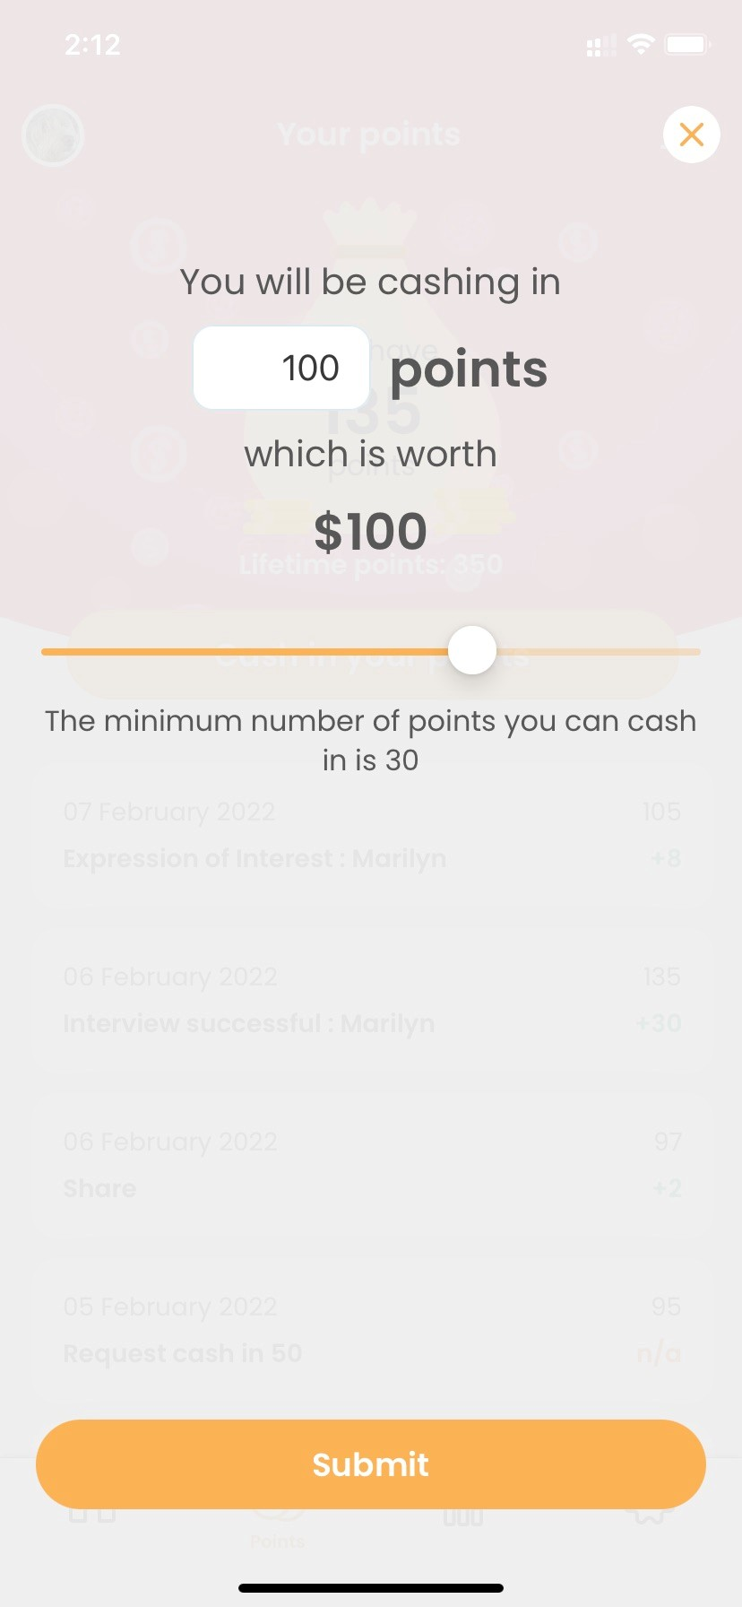
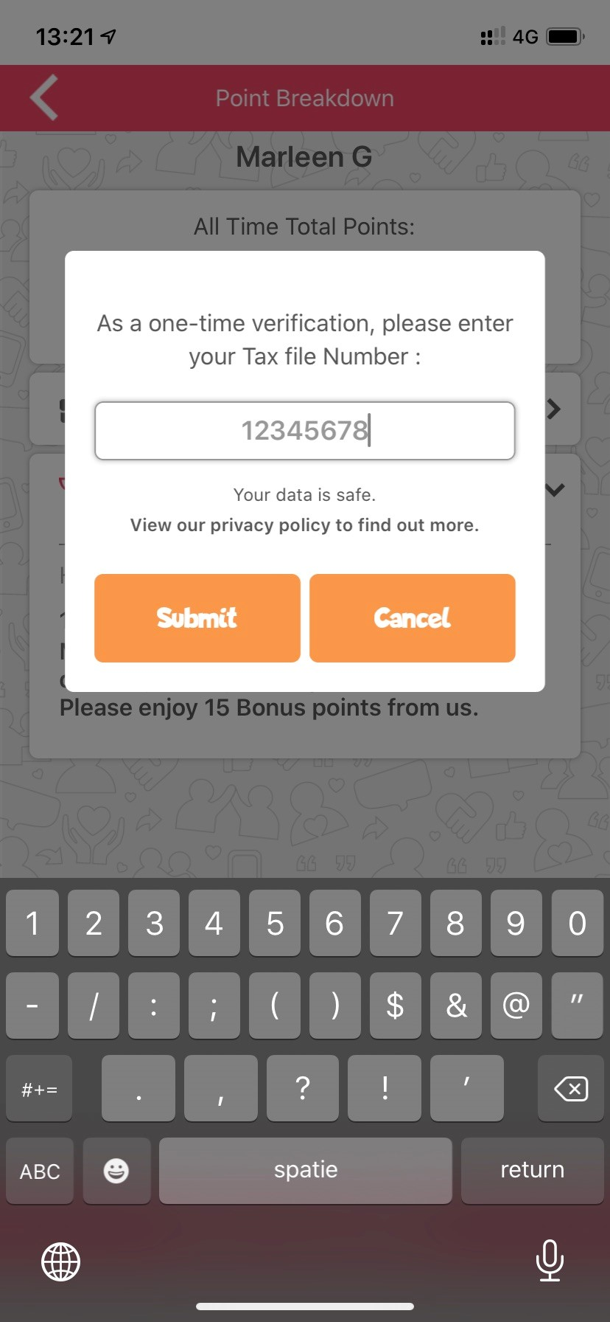
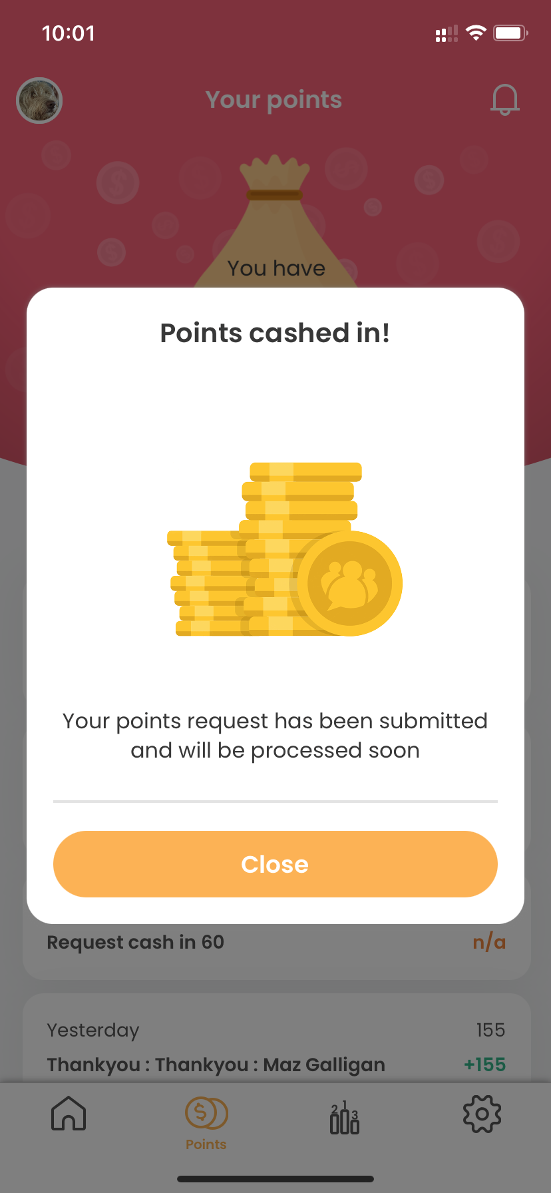
How to cash in points
1
2
3
4
5
Click on the money pouch or the money icon in the bottom menu
Click on Cash in your Points
Choose how many points
Enter your employee ID (one time only)
Success!
Employee number

Slide 17
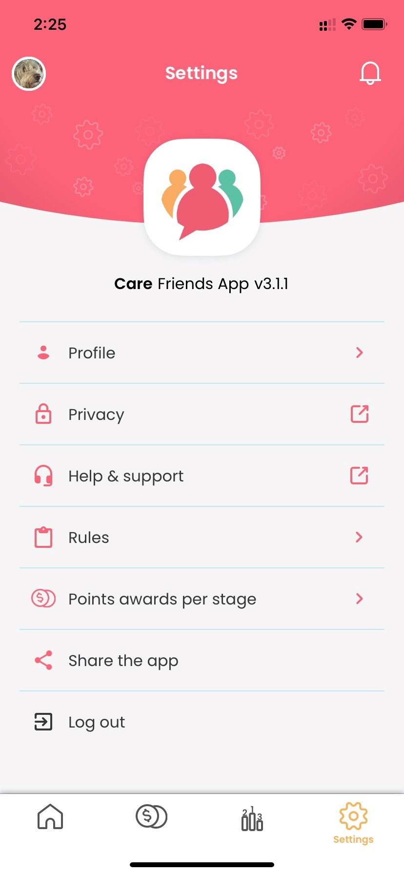
Some final bits Settings
Your notifications are here
Your scheme rules are here
The points awarded for each recruitment stage can be found here

Slide 18
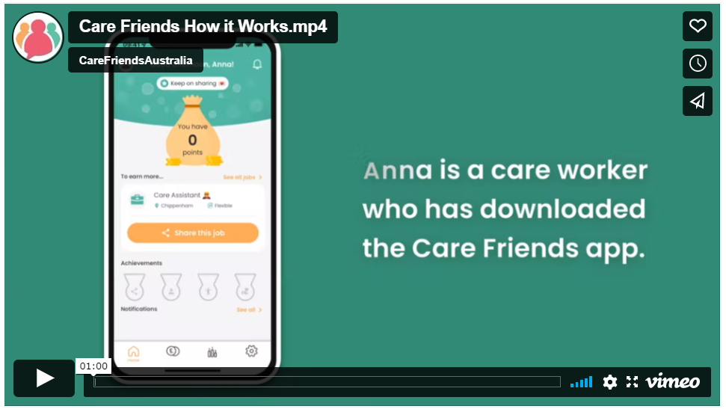
How sharing works in detail
https://vimeo.com/674696316
Notes:
This short video briefly shows how to share a job and what happens when your friend expresses their interest.
https://vimeo.com/674696316

Slide 19
Some key policy rules
Referring qualified/eligible candidates is a must. For example, referring someone who is not a nurse to an RN role will not result in points.
Referrals have to live within a commutable distance to the job location or planning to move to the area
Employees can cash in their points at any time once they reach XX points ($XX).
Referrals must be made using the Care Friends app and a referral cannot already work for us.
A job can be shared via Care Friends as many times as one likes, but will only incur points for the first 10 shares each calendar month.
Notes:
As our Champion, it is important to know some of the key rules of our referral policy.
[read out key rules. Change or add as you see fit].
You can access our full referral policy from within the Care Friends app.

Slide 20
Introducing our new employee referral program
Launch Day | Date
Care Friends Super User | Name Here
Sites/Regions | List them
Champions | List them
Notes:
[Add anything else relevant to the launch.
On launch day, we will all get together for morning tea where we introduce this new initiative to all employees. Around that time, all employees should receive a text message invite on their personal mobile phone with instructions on how to download the app. A reminder text message will be automatically sent once a week for the next 2 weeks. This will be the easiest way for employees to sign-up.
If staff want to sign up outside of that text message link, the provided QR code can be used. This QR code can also be included in new starters onboarding packs.
As Champions we hope you will encourage staff to download the Care Friends app, share jobs and refer qualified friends and family.

Slide 21
More rewards
We will also give everyone who downloads the Care Friends app XX welcome points
And as our Champion you will get bonus points when your site reaches a certain percentage of app users (first 3 months after launch)
Sign Up | Bonus Points
10% | 20
25% | 50
50% | 50
75% | 50
1 point = $1
Notes:
[copy your previous slide about “more rewards” or remove if not relevant. This is just a “reminder” slide for champions to encourage their participation]
And remember that everyone will instantly get 10 points just for downloading the app. And as champions there are some additional rewards for you to achieve as well.

Slide 22
Our new Employee Referral Program
Notes:
That’s it for now. Any questions?

